Slide 1
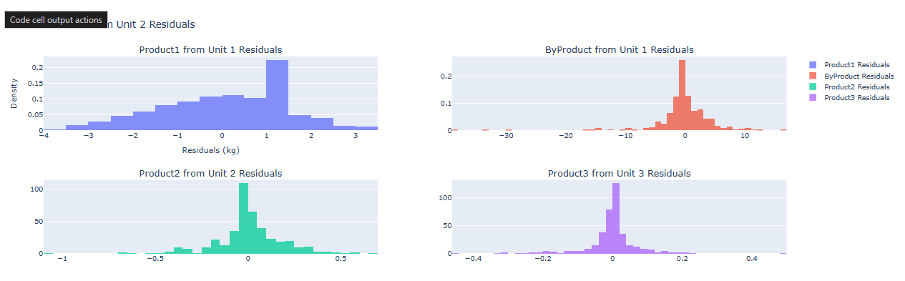
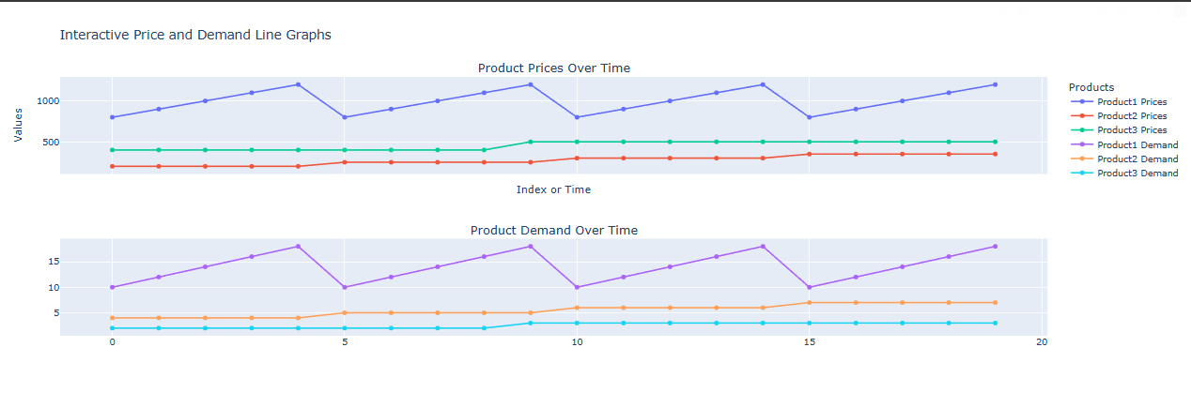
“Optimization of products leads to greater margins which can be channeled towards growth”
We fitted a model…
and gained the following insights
Producing more of product one is important because it is often in high demand
A drop in demand for product 1 results in an increase in demand for other products
The byproduct for product 1 can then be used to meet the production of Products 2 and 3

Slide 2
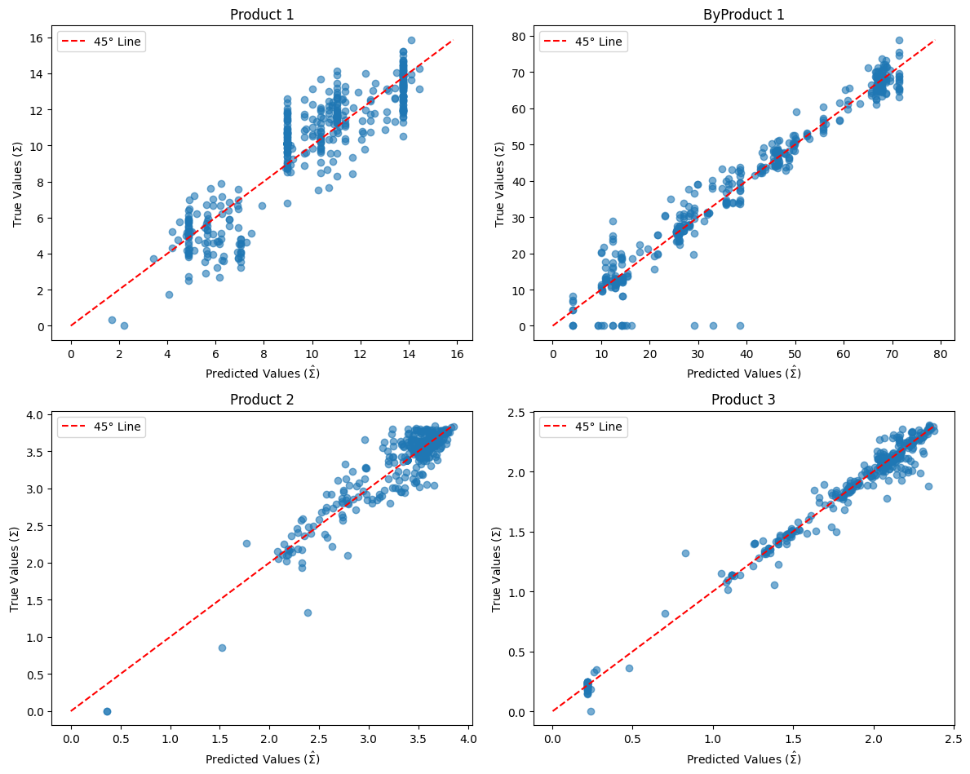
Building a Data-Driven Future with AI Optimization
Revenue Growth as the company saves money and invests in other products.
Improved Production Processes and Resource Allocation, Optimized resource usage across interlinked production lines, minimizing downtime and maximizing throughput.
A modernized and efficient production system supports future expansion, allowing ABC Pharmaceuticals to scale operations effectively.
Enhanced ability to adapt pricing and production to external market factors such as demand and pricing fluctuations.
Efficiency In Operations
The model accurately predicts the amount of each product needed daily, ensuring production aligns with demand and avoiding overproduction.
By predicting demand precisely, fewer items are disposed of, significantly reducing waste-related costs.
The model minimizes the amount of excess product stored, leading to lower storage costs and less risk associated with managing inventory.

Slide 3
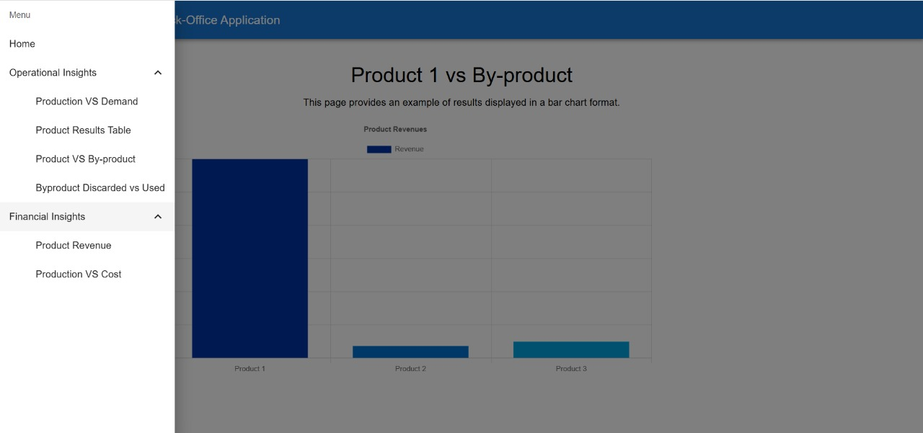
Operational and Financial Insights Overview
Analyze production metrics with a focus on matching Product Output vs Demand.
Evaluate product efficiency through a Product Results Table showing production KPIs.
Visualize the relationship between Product and By-product outputs to optimize resource allocation.
Track Byproduct Disposal and Utilization rates to ensure minimal environmental impact and cost-effectiveness.
For Future:
We are planning for the development of the Financial Insights.

